Slide 1
DineDash : Functional Decomposition Diagram
DineDash
01. Account & Subscription Management
02. Restaurant & Order Management
03. Orders & Payments
04. Delivery Management
05. Advertisement Management
06. Customer Support
Saransh
Sumedh
Sandeep
Harsh
Kiran V.
Andrew

Slide 2
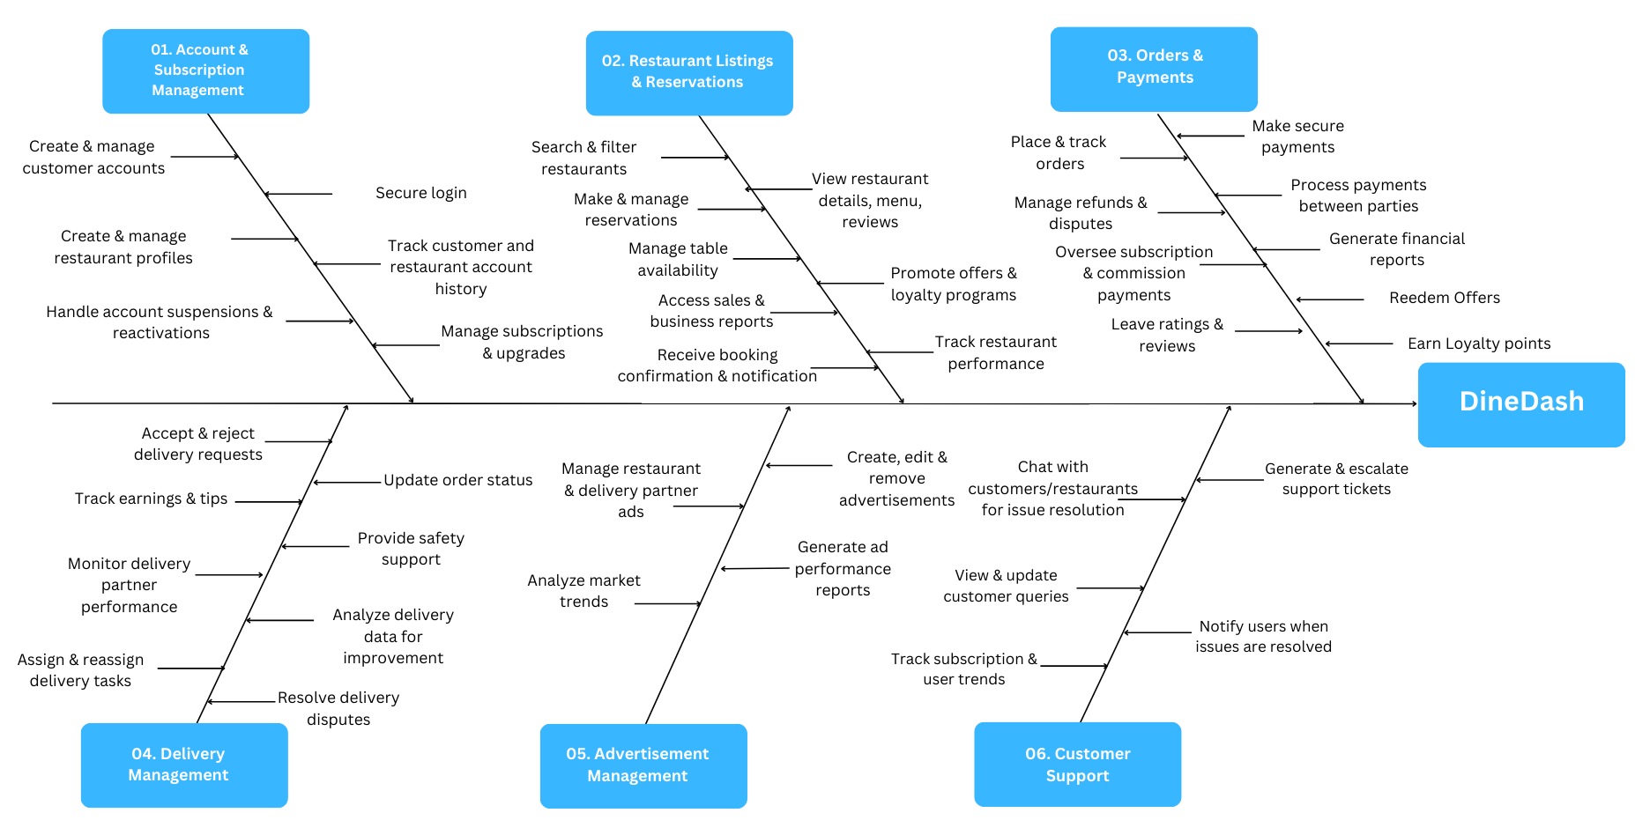
DineDash : Fish Bone Diagram

